Slide 1

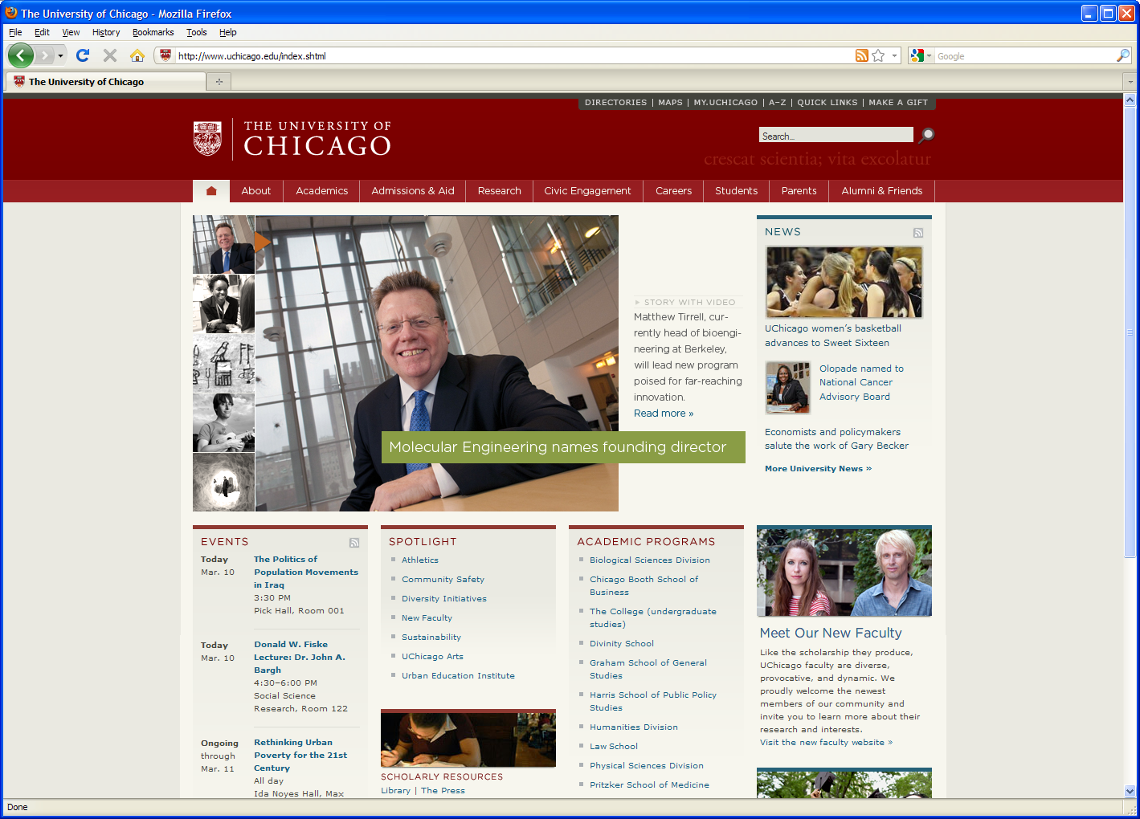
The Research Computing Center GIS Support (GIS-RCC)
Parmanand Sinha

Slide 2



Training and Workshops
Software
Spatial Data Mining
Visualization
Geocoding
WebGIS
Consulting
Notes:
RCC-GIS distributes and supports various GIS software platforms for analytics and map creation on a personal computer or in a server-based environment

Slide 3
Proprietary GIS Software
Free ArcGIS online
ESRI ArcGIS for Desktop
ESRI ArcGIS Pro
ESRI ArcGIS for Server
Other ESRI software products
AppStudio for ArcGIS
Esri CityEngine
Students licensing is available for enrolled students.

Slide 4
Spatial Packages on Midway Cluster
PostGIS
GDAL
GEOS
GrADS
Grass
PROJ.4
QGIS
R
Python 2
Python 3
Julia
Matlab
Stata
SAS
IDL
User can install PYSAL or any other spatial packages python.

Slide 5
Geocoding Coverage
Geocode coverage level 1 to 4

Slide 6
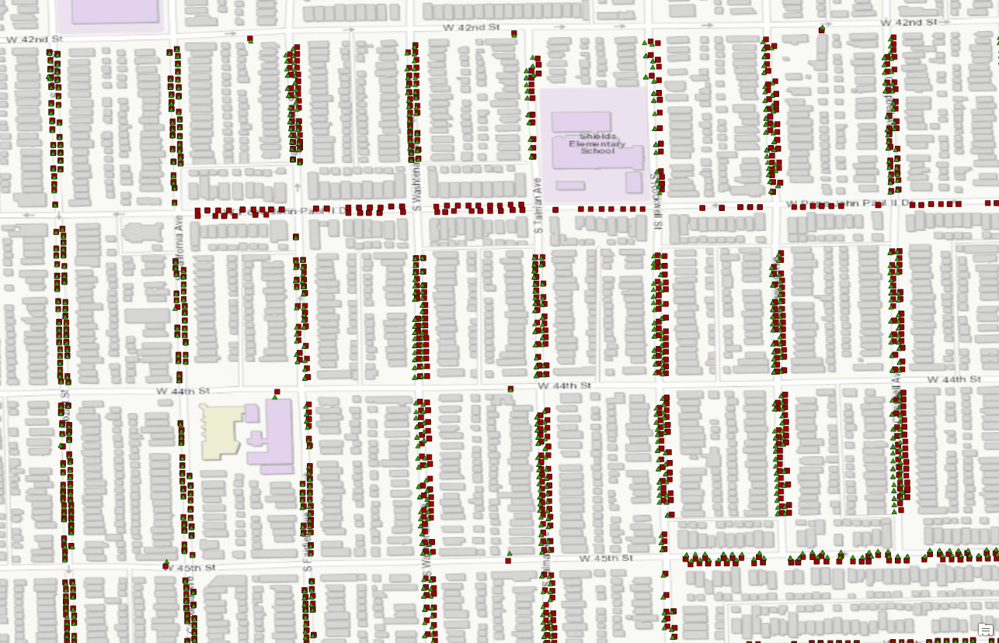
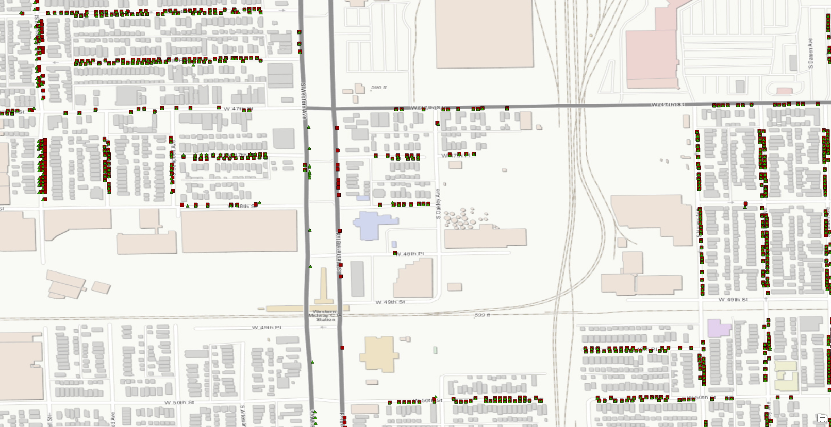
red rectangles local address locator
green triangles ESRI world geocoder
For small Geocoding workload
Google API 2500 addresses free per day

